Slide 1
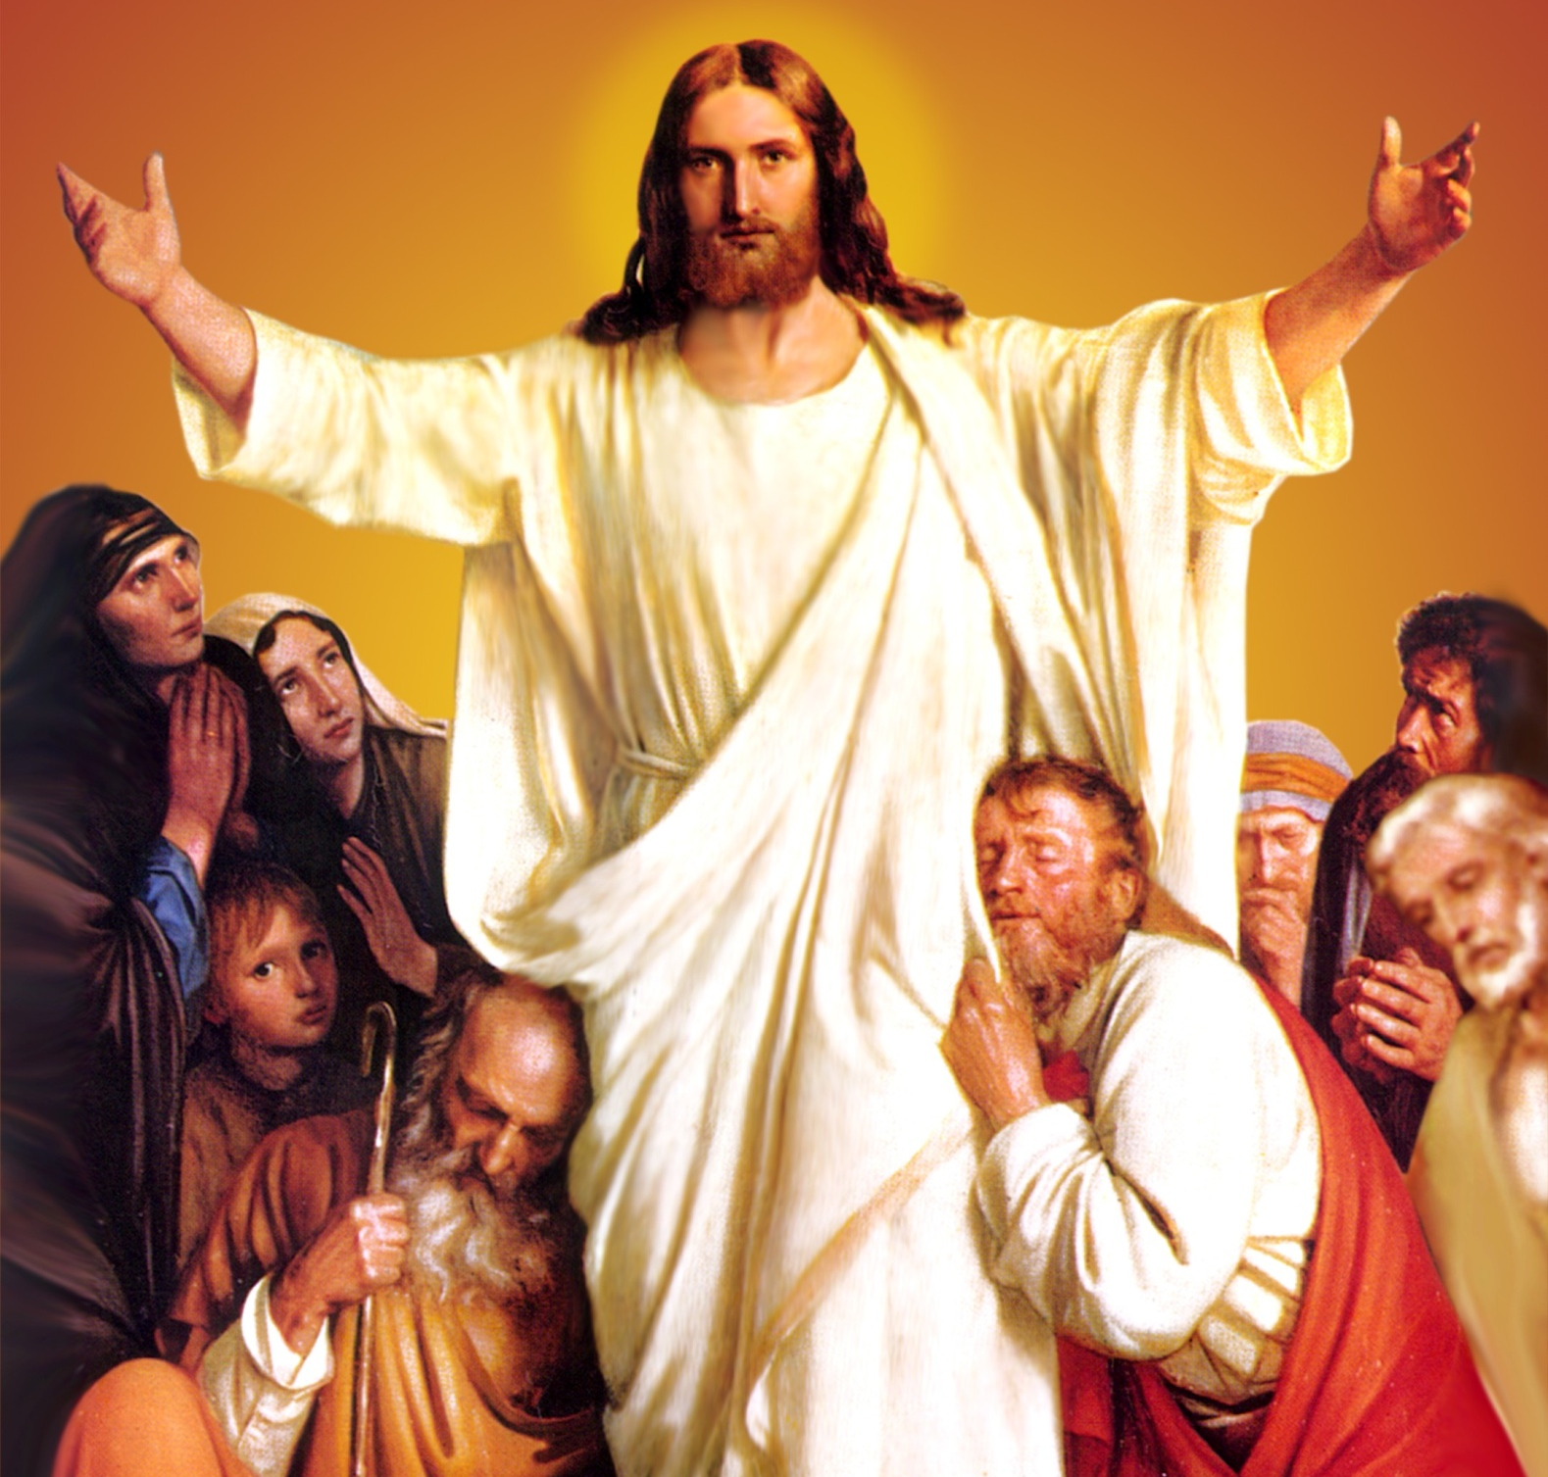
CATECHETICAL TEXTBOOK SERIES OF THE SYRO - MALABAR CHURCH
ON THE PATH OF SALVATION - 6
PEOPLE WHO
EXPERIENCED JESUS
6

Slide 2
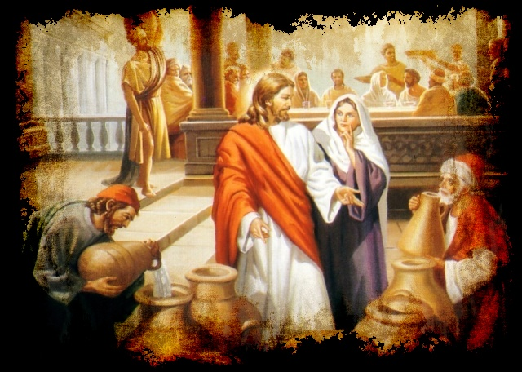
LESSON 5
JESUS WHO REVEALED THE GLORY OF GOD

Slide 3
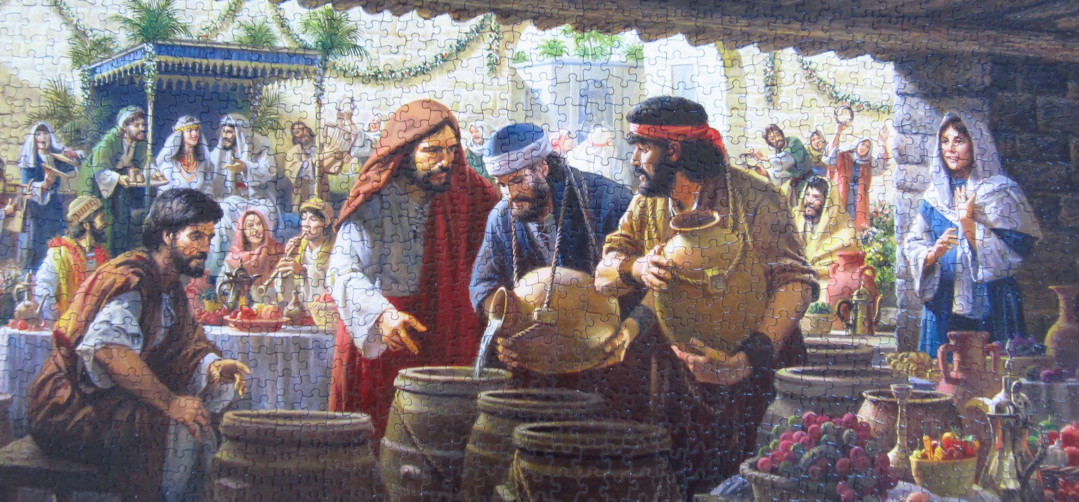
There was a wedding at Cana in Galilee, and Mary, the mother of Jesus was there. Jesus and his disciples had also been invited to the wedding. During the festivities there was panic among the family members. The reason was that they had run out of wine. Wine is an important drink at a Jewish wedding and not to have enough of it is a matter of shame. Realizing the predicament of the people, Mary went to Jesus and said, “They have no wine”. And Jesus said to her, “Woman, what concern is that for you and me? My hour has not yet come”. However, with absolute trust in the Son of God, Mary said to the attendants, “Do whatever he tells you”. Out of respect for his mother's wish Jesus performed a miracle.

Slide 4
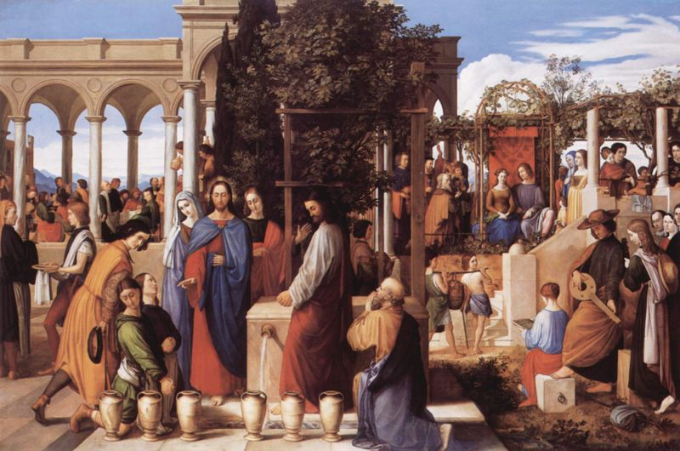
Now standing there were six stone water jars for the Jewish rite of purification, each holding twenty or thirty gallons. Jesus said to them, “Fill the jars with water.” And they filled them up to the brim. Jesus asked them to take some of it to the steward and when they did so it had become wine of superior quality and tasted so. This miracle was the beginning of the signs he performed to reveal his glory, and his disciples believed in him. (Jn. 2: 1- 11).

Slide 5
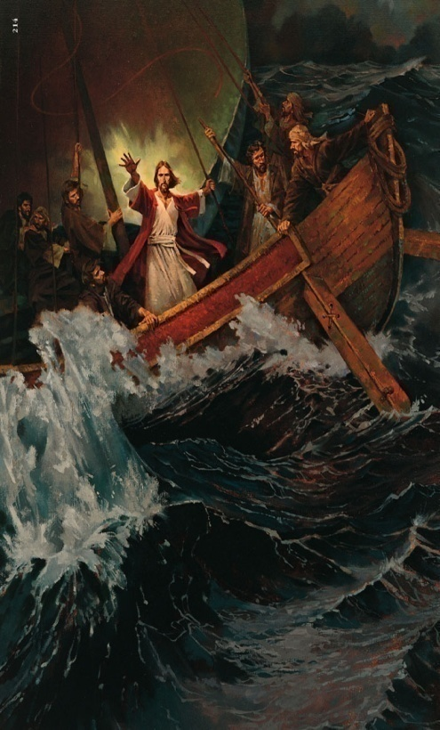
JESUS CALMS THE STORM
On another occasion Jesus was crossing the lake of Galilee in a boat along with His disciples. A great storm arose, and the waves beat into the boat, so that the boat was already being swamped. But he was in the stern, asleep on a cushion; and they woke him up and said to him, “Teacher, do you not care that we are perishing?” He woke up and rebuked the wind, and said to the sea, “Peace, be still!” Then the wind ceased, and there was dead calm. He said to them, “Why are you afraid? Have you still no faith?” And they were filled with great awe and said to one another, “Who is this, that even the wind and the sea obey him?” (Mk. 4: 35- 41). We learn from this miracle that no matter what hardship we face in the voyage of life, we shall be all right as long as Jesus is with us.

Slide 6
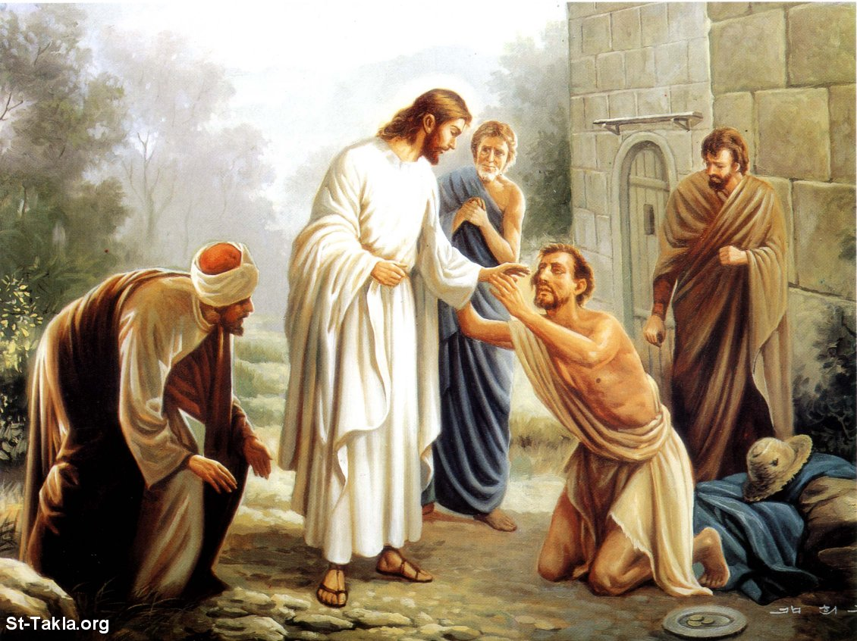
HEALING AT BETHZATHA
Once Jesus went up to Jerusalem for a festival of the Jews. Now in Jerusalem, by the sheep gate there is a pool, called in Hebrew Bethzatha, which has five porches. In these lay many invalids - blind, lame and paralyzed. There was a man who had been ill for thirty eight years. When Jesus saw him lying there and knew that he had been there a long time, he said to him, “Do you want to be made well?” The sick man answered him, “Sir, I have no one to put me into the pool when the water is stirred up; and while I am making my way some one else steps down ahead of me.” Jesus said to him, “Stand up, take your mat and walk.” At once the man was made well and he took up his mat and began to walk (Jn. 5: 1- 15). Through this miracle Jesus reveals his glory as the Son of God.

Slide 7
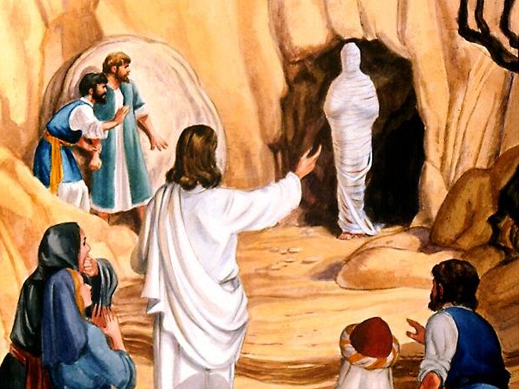
LAZARUS RAISED TO LIFE
Another incident that reveals the divine glory of Jesus is when Jesus raises to life Lazarus who was dead. Lazarus, the brother of Martha and Mary, was a close friend of Jesus. He fell ill and his condition was very serious. So his sisters sent word to Jesus informing him of the condition. However it was only after two more days that Jesus decided to travel to Bethany to visit them. For he knew that this illness was for the glory of God and for the son of God to be glorified through it.

Slide 8
Jesus and the disciples reached Bethany on the fourth day after the death of Lazarus. As soon as she saw Jesus, Martha ran up to him and said, “Lord, if you had been here, my brother would not have died. But even now I know that God will give you whatever you ask Him.” Jesus said to her, “Your brother will rise again.” But Martha thought that Jesus was talking of the resurrection on the last day. So Jesus said to reassure her, “I am the resurrection and the life. Those who believe in me, even though they die, will live. And every one who lives and believes in me will never die. Do you believe this?” And Martha proclaimed her faith saying, “Yes Lord I believe that you are the Messiah, the Son of God, the one coming into the world.”

Slide 9
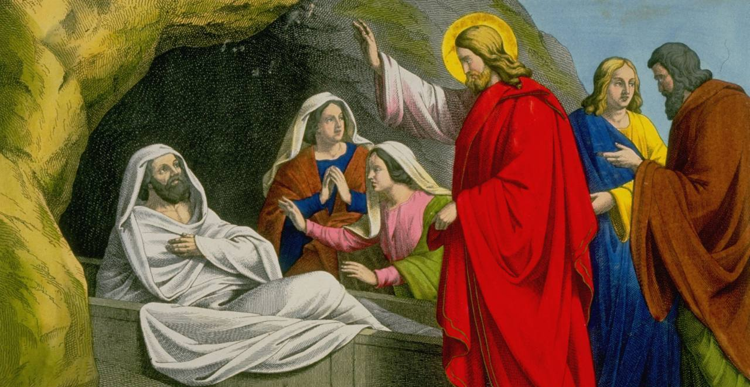
Jesus came to the tomb. He asked that the stone be removed from the mouth of the cave that served as the tomb. Trying to stop him, Mary said, “Lord already there must be a stench because he has been dead four days.” Jesus said to her, “Did I not tell you that if you believe, you will see the glory of God?” So they took away the stone. Jesus raised his eyes and after praying to his Father said in a loud voice, “Lazarus, come out!” Then Lazarus came out alive. Many among the Jews believed in Jesus (Jn. 11: 1- 44).
Through all these miracles Jesus was manifesting the divine glory in him. Like the people who believed in him seeing his miracles, let us also believe in him and proclaim his glory.

Slide 10
Let us pray
O! Jesus, who transformed water into wine at Cana through the intercession of Mary, teach us to face the problems and difficulties of our life by trusting in you.

Slide 11
Read the word of god:
John 11:1-44

Slide 12

WORD OF GOD FOR GUIDANCE
"I am the resurrection and the life, those who believe
in me, even though they die, will live" (Jn. 11:25)

Slide 13
LET US DO:
Find out from the gospels the miracles done by Jesus.
Write the names of five miracles in which people
glorified the name of God.

Slide 14
MY DECISION
I will try to see the providence of God in the
victories and defeats of my daily life.

Slide 15
LET US Find out the answer
1. What is it that persuaded Jesus to work the miracle at Cana?
2. How did the disciples react when they saw Jesus calming the sea?
3. What was the Word uttered by Jesus while healing the paralyzed man at Bethzaida?
4. Why did Jesus delay to go to Bethany even after knowing that Lazarus was seriously sick?
5. What was the Word Jesus uttered to Martha, revealing himself, before raising Lazarus from the dead?

Slide 16
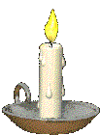


Thank you

